Slide 1
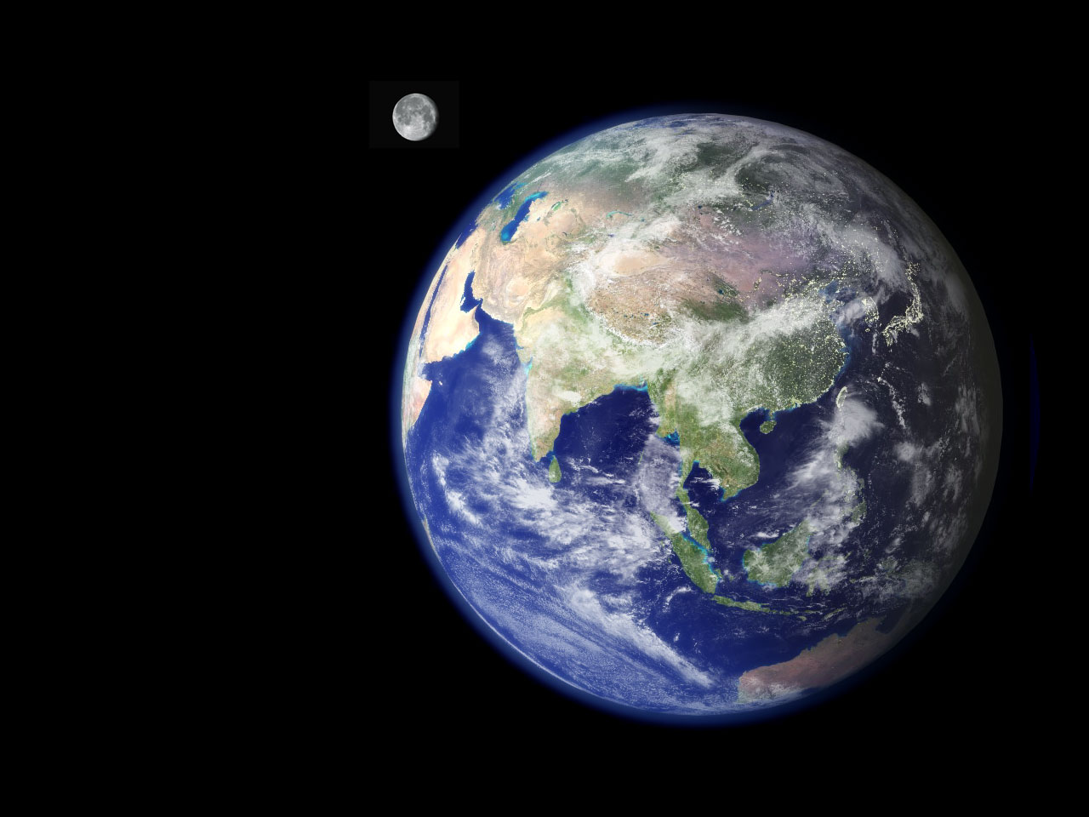
Geography
and
Careers
Support units: Why teach geography?
Illustration 1: Geography and careers
Notes:
Mount Nyiragongo, Democratic Republic of the Congo

Slide 2
There has never been a more exciting time to study geography
Geography helps makes sense of an increasingly complex world
Geographers are highly employable and have diverse career paths

Slide 3
The importance of Geography
'The study of geography is about more than just memorising places on a map. It's about understanding the complexity of our world, appreciating the diversity of cultures that exists across continents. And in the end, it's about using all that knowledge to help bridge divides and bring people together.'
Barak Obama
President of the United States
National Geographic Bee 2012 featuring President Obama YouTube video

Slide 4
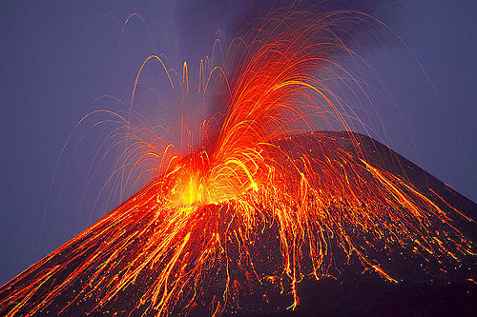
What is geography all about?
Natural environments

Slide 5
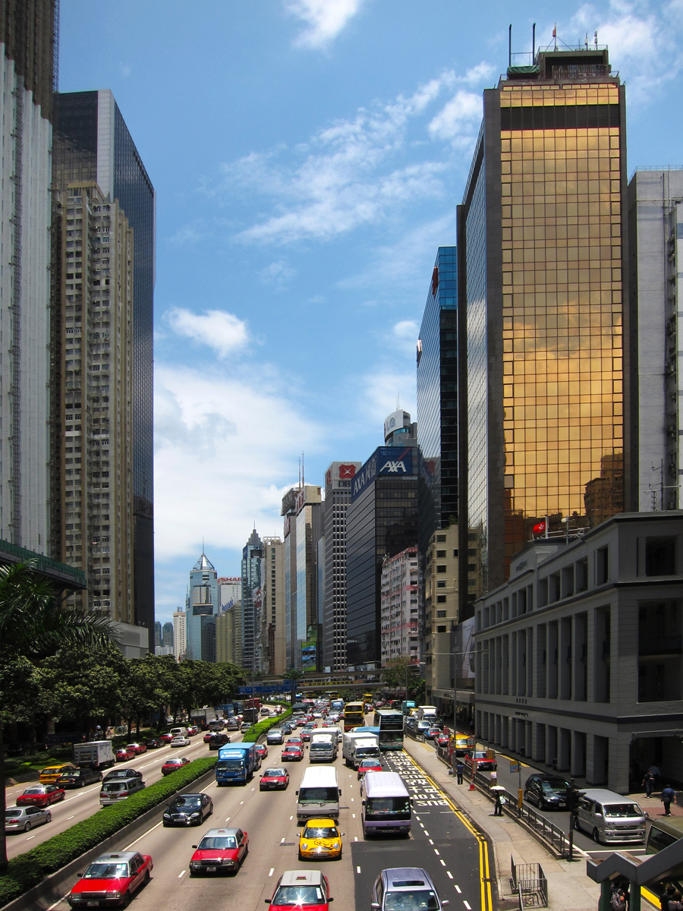
Human environments
Notes:
Ho Chi Minh City, Vietnam

Slide 6
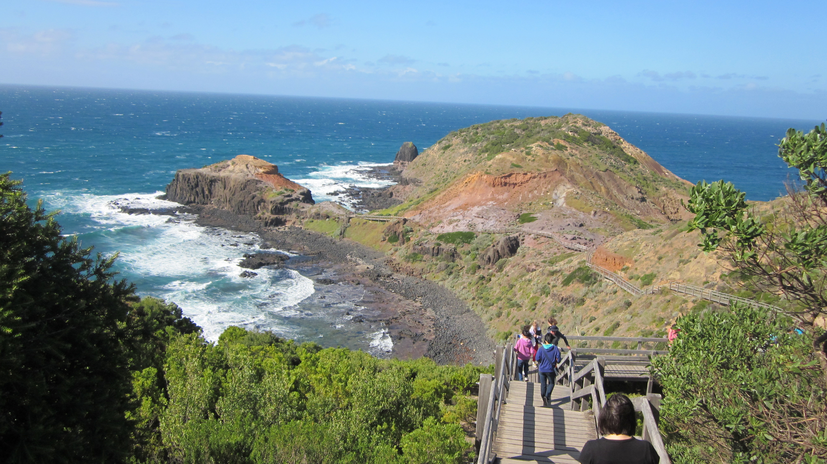
Fieldwork
Notes:
Cape Schanck, Mornington Peninsula

Slide 7
Regional resources
Notes:
Goolwa – a river port on the Murray River in the Murray Darling Basin.

Slide 8
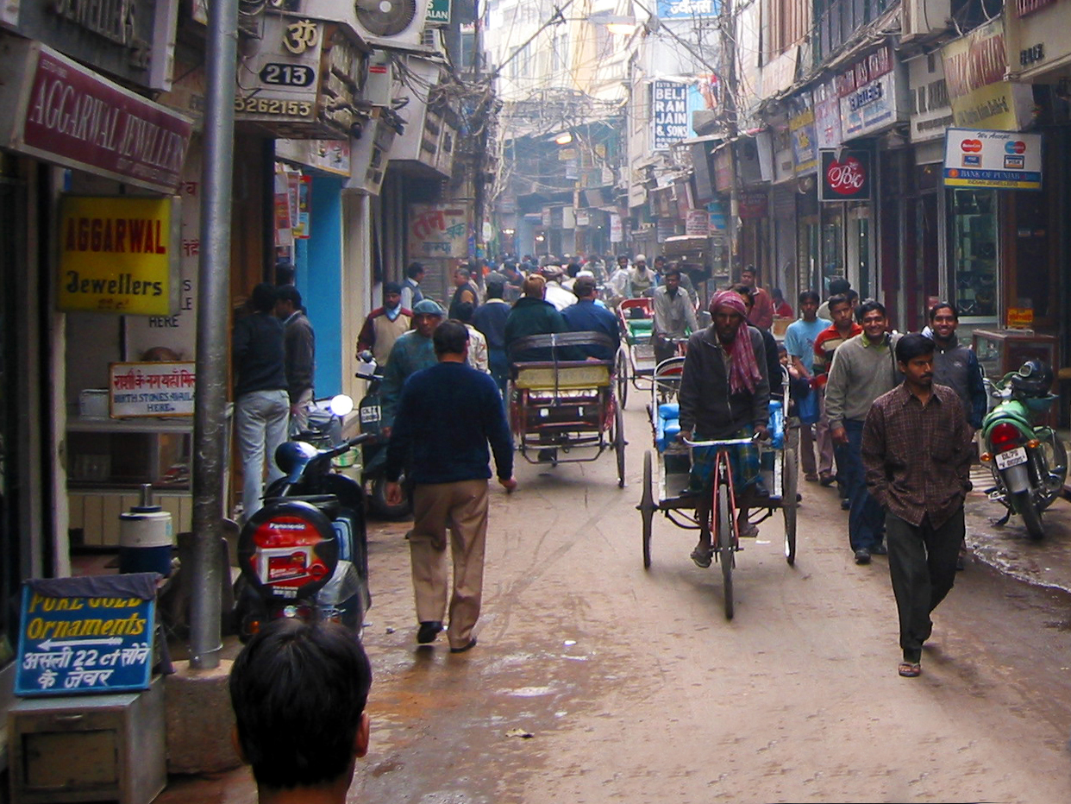
Global perspectives
Notes:
Tokyo

Slide 9
Why study geography on today’s schools
YouTube video
Teachers and students at John Monash Science School Melbourne give some great reasons on why students should study Geography

Slide 10
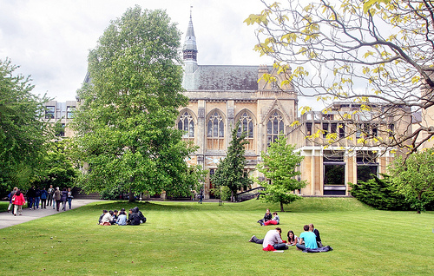
Tertiary courses linked to geography
Geography can be an integral part of your tertiary education . . . some examples . . .
Bachelor of Science – Geospatial Science

Slide 11
Bachelor of Urban and Rural Planning
Notes:
A model of Shanghai 2020

Slide 12
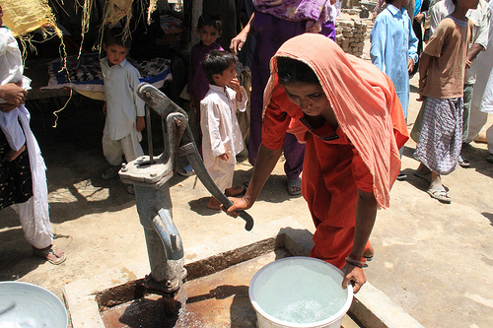
Bachelor of Global Studies with Bachelor of Laws (double degree)

Slide 13
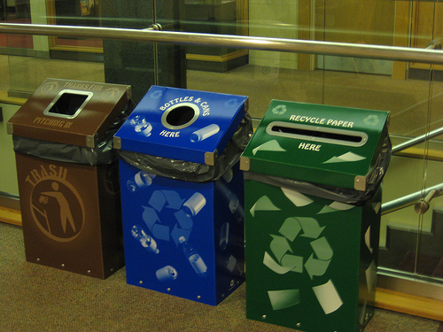
Bachelor of Arts – Sustainability Management

Slide 14
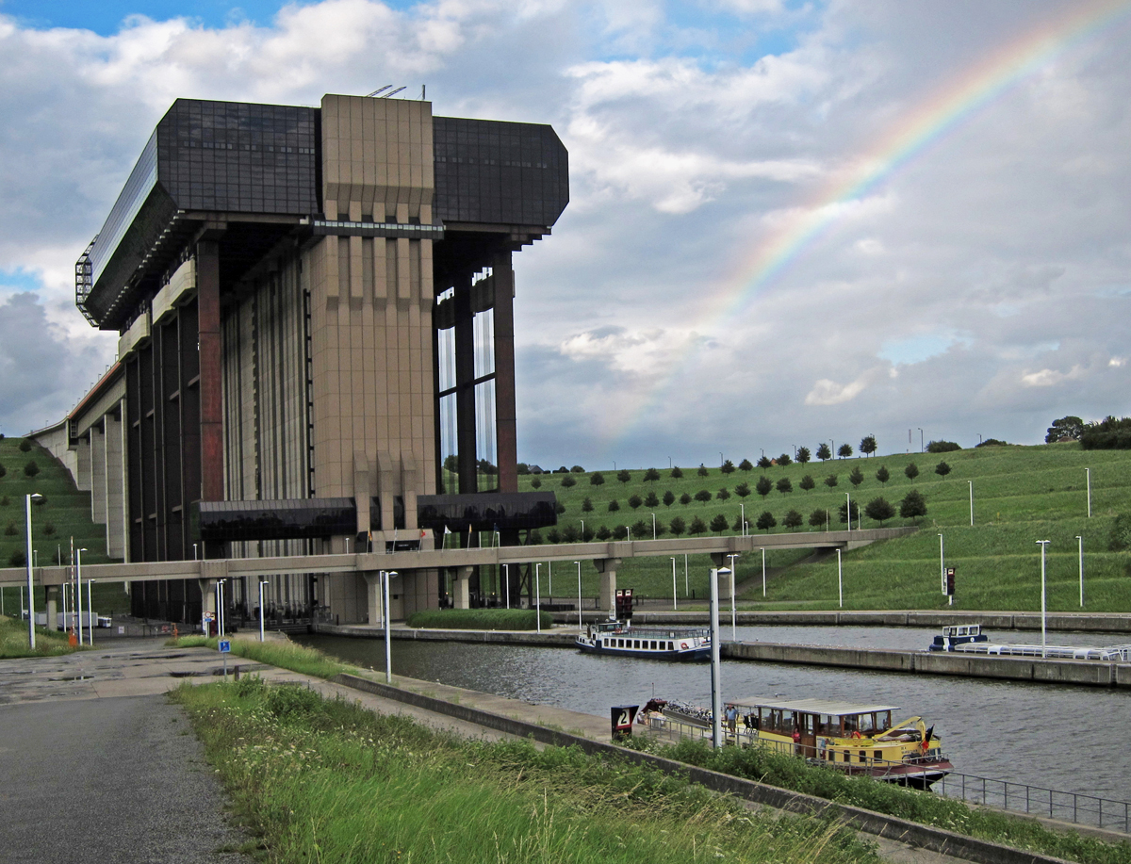
Bachelor of Engineering – Environmental Engineering

Slide 15
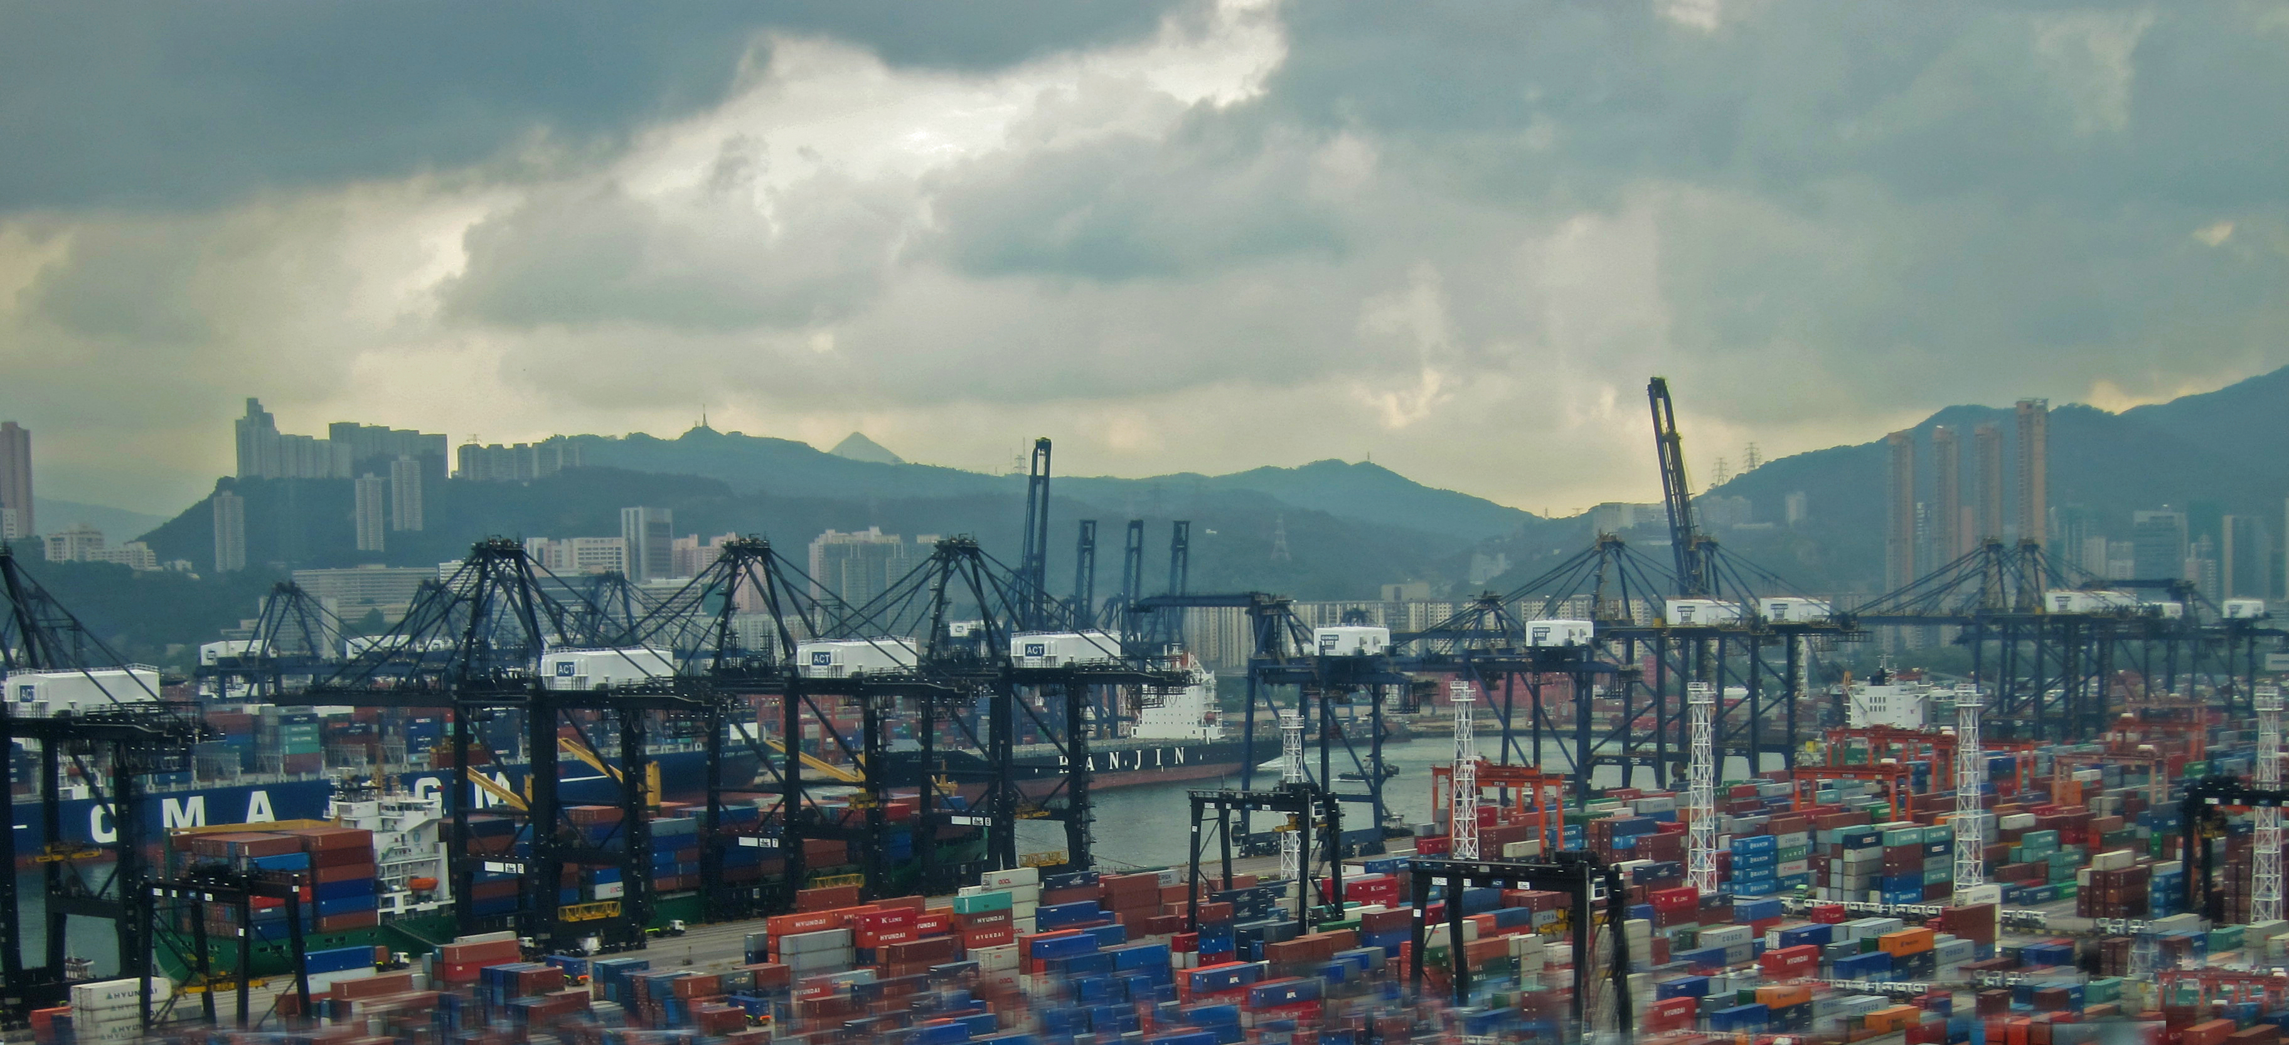
Bachelor of Supply Chain and Logistics Management

Slide 16
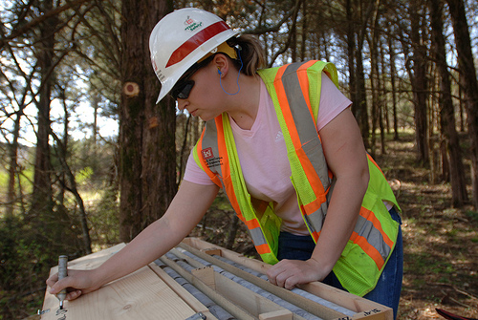
Bursaries and Cadetships
There are many bursaries and cadetships available for students in geography-related courses

Slide 17
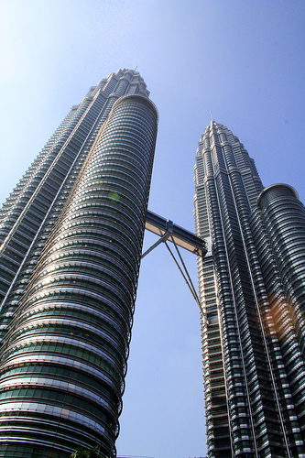
Geography in the workplace
Planning and Design – Architecture

Slide 18
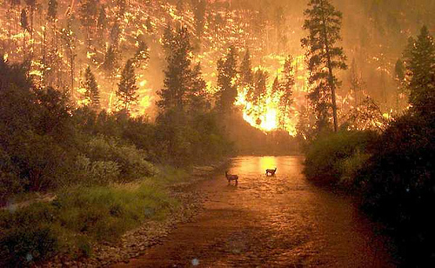
Environment – Disaster Management

Slide 19
Science, Engineering and Physical Geography – Oceanography

Slide 20
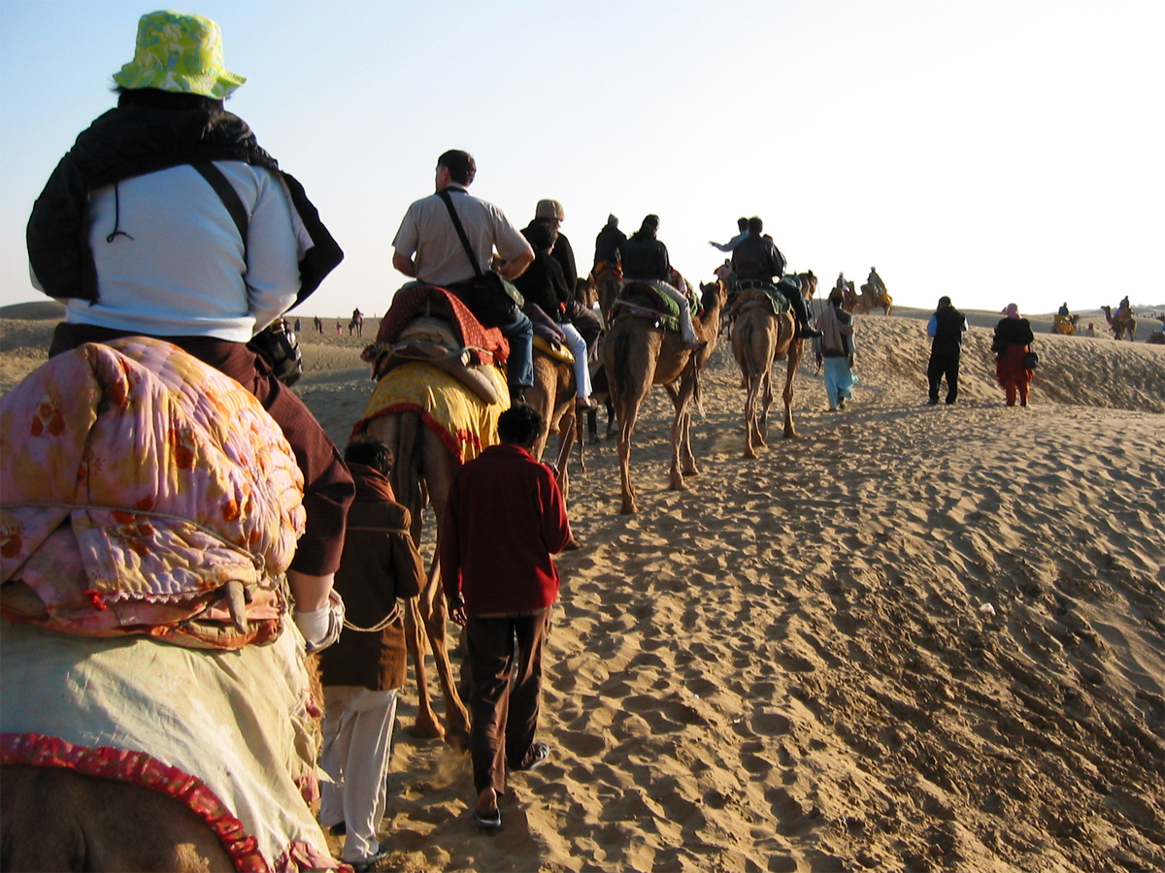
Humanities – Ecotourism

Slide 21
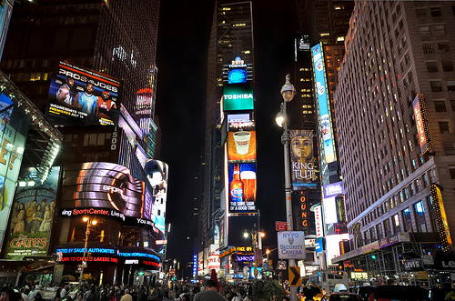
Commerce – Advertising

Slide 22
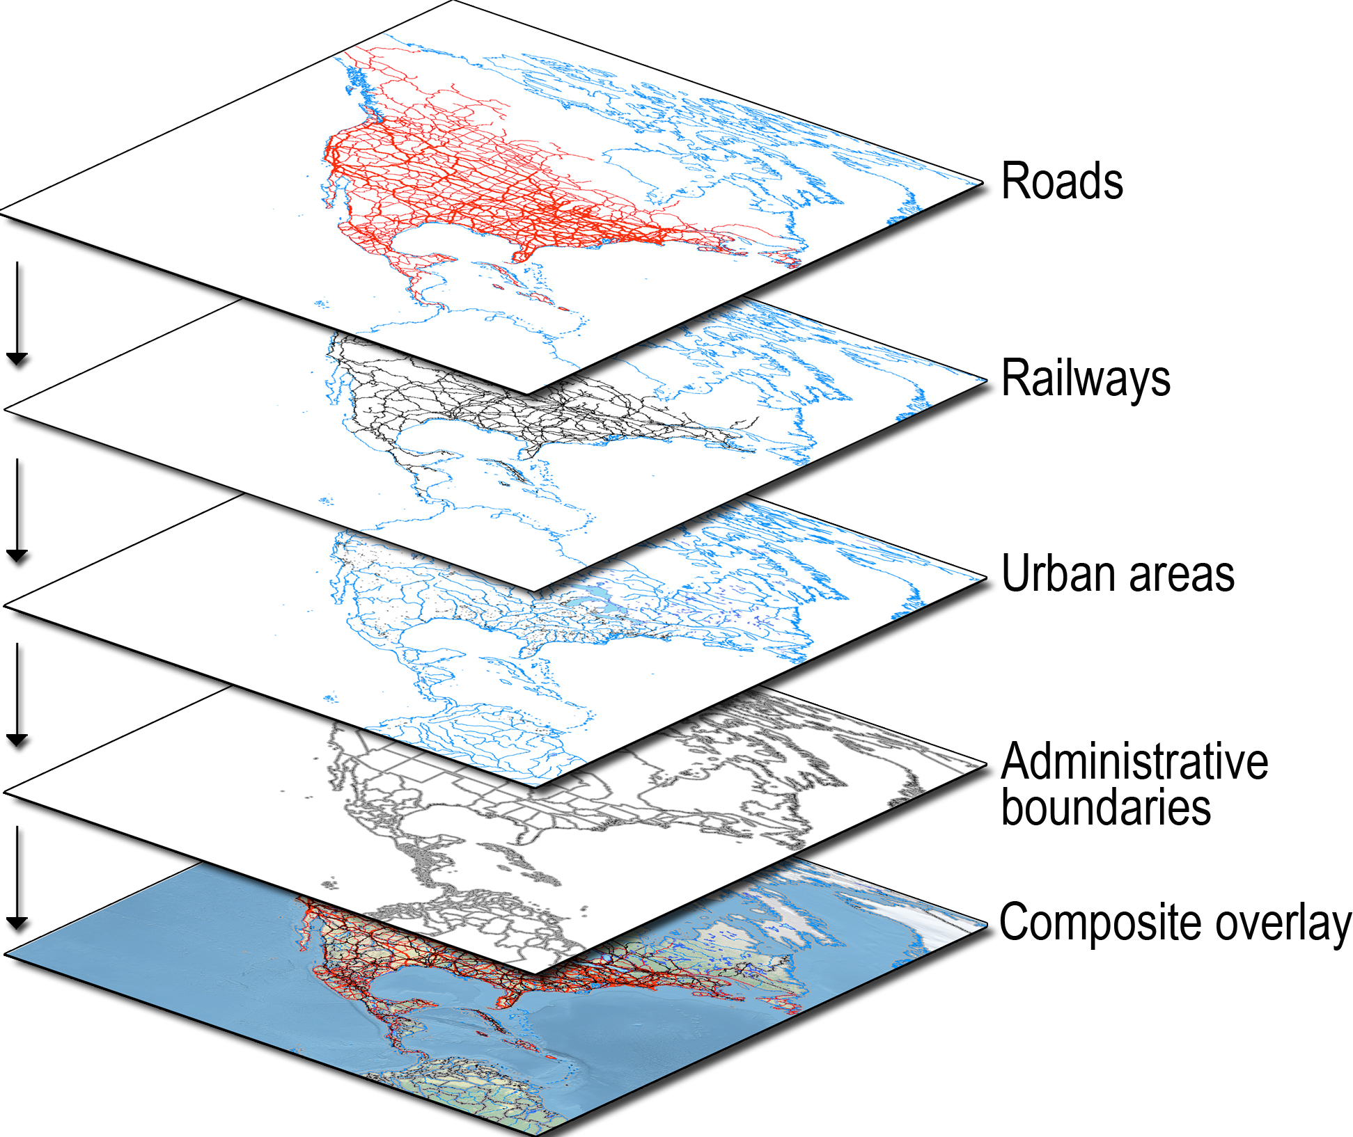
Spatial Sciences – Geographic Information Systems (GIS)

Slide 23
An understanding of spatial technologies is essential to make sense of our world
Geography in the spatial industry
The Geospatial Revolution project, developed by Penn State University Public Broadcasting shows us the world of digital mapping and how it is changing the way we think, behave and interact
Geospatial Revolution
YouTube video

Slide 24
The spatial industry, both in Australia and internationally, is growing
Recent estimates by the Spatial Industries Business Association (SIBA) Australia put the current labour shortage of spatial professionals in the Australian workforce at up to 3,000 to 4,000 people
For more information visit Destination Spatial

Slide 25
Geography can provide you with a passport to a myriad of career opportunities

